Slide 1

Performance Measurement

Slide 2
How do we compare algorithms?
We need to define a number of objective measures.
1) Compare execution times?
(
Not good: times are specific to a particular computer !!
(2) Count the number of statements executed(step count)?
Not good: number of statements vary with the programming language as well as the style of the individual programmer.

Slide 3
Performance Measurement
Which is better?
T(P1) = (n+1) or T(P2) = (n² + 5).
T(P1) = log (n² + 1)/n! or T(P2) = n^{n}(nlogn)/n².
Complex step count functions are difficult to compare.
For comparing, ‘rate of growth’ of time and space complexity functions is easy and sufficient.

Slide 4
Ideal Solution
Express running time as a function of the input size n (i.e., f(n)).
Compare different functions corresponding to running times.
Such an analysis is independent of machine time, programming style, etc.

Slide 5
What is running time analysis?
Determine how running time increases as the size of the problem increases.

Slide 6
Kinds of analyses
Worst-case: (usually)
• T(n) = maximum time of algorithm on any input of size n.
Average-case: (sometimes)
• T(n) = expected time of algorithm over all inputs of size n.
• Need assumption of statistical distribution of inputs.
Best-case:
• Cheat with a slow algorithm that works fast on some input.

Slide 7
Performance Measurement
Worst case
Provides an upper bound on running time
An absolute guarantee that the algorithm would not run longer, no matter what the inputs are
Best case
Provides a lower bound on running time
Input is the one for which the algorithm runs the fastest
Average case
Provides a prediction about the running time
Assumes that the input is random

Slide 8

Growth of Functions
functions that map input size to (typically, worst-case) running time/space cost.
Termed as “asymptotic growth” of functions.
focus - how the function behaves as its input grows large.
describing families of functions that share similar asymptotic behavior.
ignore small input sizes, constant factors, lower-order terms in polynomials, and so forth.
describe how a function grows

Slide 9
Asymptotic Analysis
To compare two algorithms with running times f(n) and g(n), we need a rough measure that characterizes how fast each function grows.
Hint: use rate of growth
Compare functions in the limit, that is, asymptotically!
(i.e., for large values of n)

Slide 10
Asymptotic Notation
The notation we use to describe the asymptotic running time of an algorithm are defined in terms of functions whose domains are the set of natural numbers
These notations are convenient for describing worst-case running time function T(n) where n is input size

Slide 11
Asymptotic Notation
O notation:
Ω notation:
Θ notation:
little “oh”
little omega

Slide 12
Big -O notation
asymptotic upper bound of this function Ie: worst case
Most commonly used
f(n)-rate of growth of time of an algorithm for an input n.
FIND another function g(n) such that there exist a value of +ve integer n & n0 and a positive constant c such that f(n)<=C.g(n) ; n>=n0, C>0, n0>=1( in all case)
Then we can write
f(n)= O(g(n))
Hence function g(n) is upper bound for function f(n) and g(n) grows faster than f(n)

Slide 13
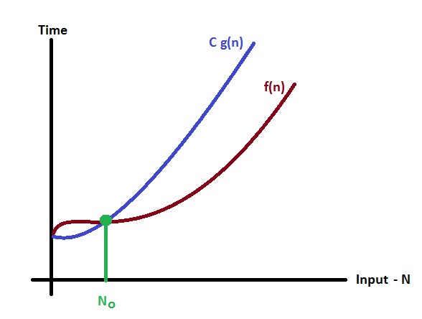
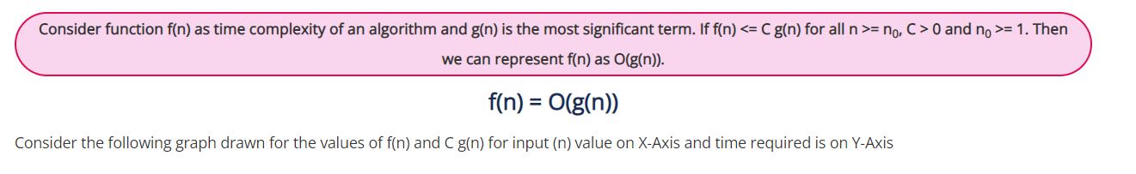
Asymptotic notations- Big oh- O

Slide 14
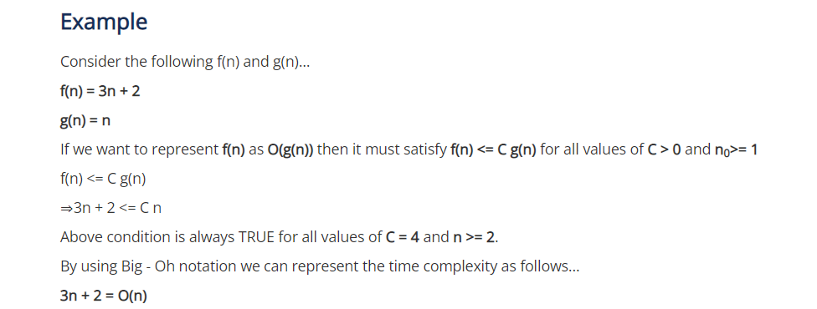
Let f(n)= 3n+2, g(n)= n Check whether we can write f(n)= O(g(n))

Slide 15
Big Omega Ω - notation
Give lower bound(best case) of an algorithm
Big-Omega notation always indicates the minimum time required by an algorithm for all input values.
That means Big-Omega notation describes the best case of an algorithm time complexity. Let f(n) & g(n) be two functions
We can write f(n)= Ω g(n)
If f(n)>=c. g(n)
for all c>0 and n >=n0

Slide 16
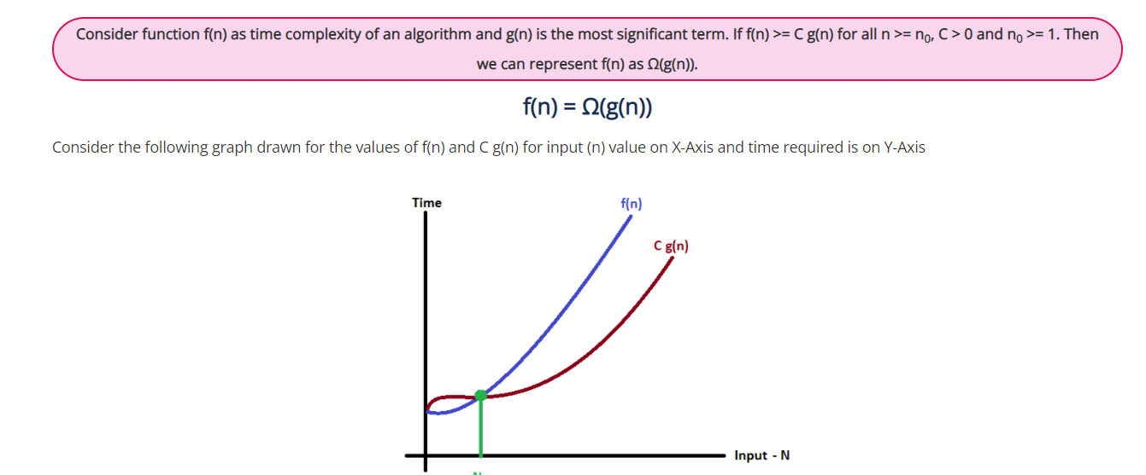

Slide 17
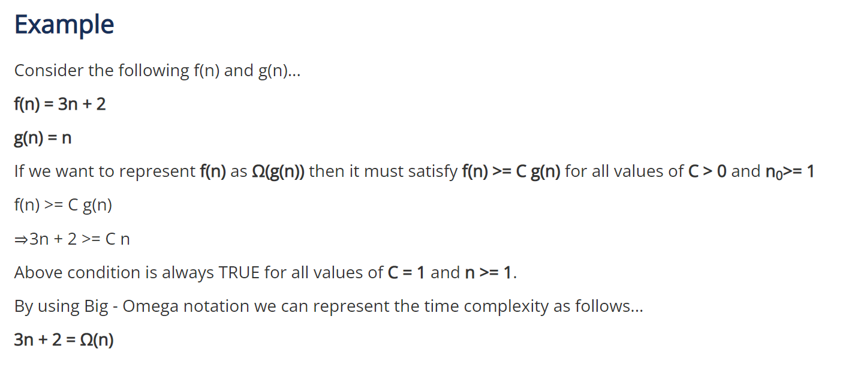

Slide 18
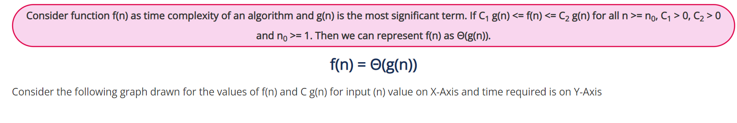
Asymptotic notations (cont.)
Θ-notation
Big - Theta notation is used to define the average bound of an algorithm in terms of Time Complexity.
That means Big - Theta notation always indicates the average time required by an algorithm for all input values.
That means Big - Theta notation describes the average case of an algorithm time complexity.
Big - Theta Notation can be defined as follows...

Slide 19
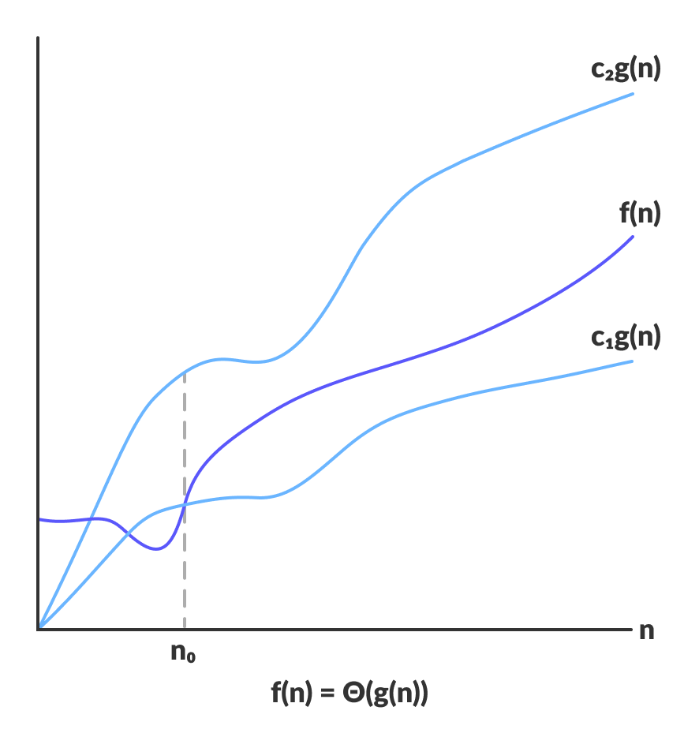

Slide 20
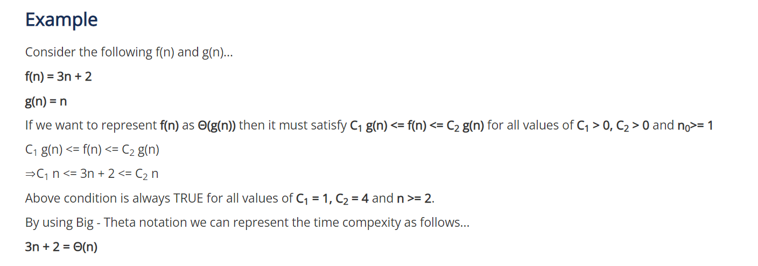

Slide 21
Example
Need to search (linear) n elements in an array
1 ,2,5, 7, 8
Best case x=1 only one comparison,1 step
complexity Ω(1)
Worst case
compare all n elements O(5)
Averagecase Θ(n/2)= Θ(n)

Slide 22


Definition:- [little “oh”] The function f(n) = o(g(n)) (read as “f of n is little oh of g of n”) if and only if
Definition:- [little omega] The function f(n) = ω(g(n)) (read as “f of n is little omega of g of n”) iff

Slide 23
we analyzed linear search and binary search by counting the maximum number of guesses we need to make
we really want to know is how long these algorithms take. We're interested in time, not just guesses
The running time of an algorithm depends on how long it takes a computer to run the lines of code of the algorithm—and that depends on the speed of the computer, the programming language, and the compiler that translates the program from the programming language into code that runs directly on the computer, among other factors.

Slide 24
Let's think about the running time of an algorithm more carefully. We can use a combination of two ideas.
First, we need to determine how long the algorithm takes, in terms of the size of its input.
We've already seen that the maximum number of guesses in linear search and binary search increases as the length of the array increases
we think about the running time of the algorithm as a function of the size of its input.

Slide 25
The second idea is that we must focus on how fast a function grows with the input size.
We call this the rate of growth of the running time.

Slide 26
For example, suppose that an algorithm, running on an input of size n, takes 6n^2 + 100n + 300 machine instructions
6n^2 larger when compared to rest part when n is large
So drop coefficient of 6n^2
RUNNING TIME GROWS AT N^2

Slide 27
Asymptotic Notation
O notation: asymptotic “less than”:
f(n)=O(g(n)) implies: f(n) “≤” g(n)
Ω notation: asymptotic “greater than”:
f(n)= Ω (g(n)) implies: f(n) “≥” g(n)
Θ notation: asymptotic “equality”:
f(n)= Θ (g(n)) implies: f(n) “=” g(n)

Slide 28
Relationship between o, Θ , Ω
Big O → worst case
Ω → best case
Θ → averagecase
Always Interested in worst case
Average case used when best & worst case same

